Slide 1
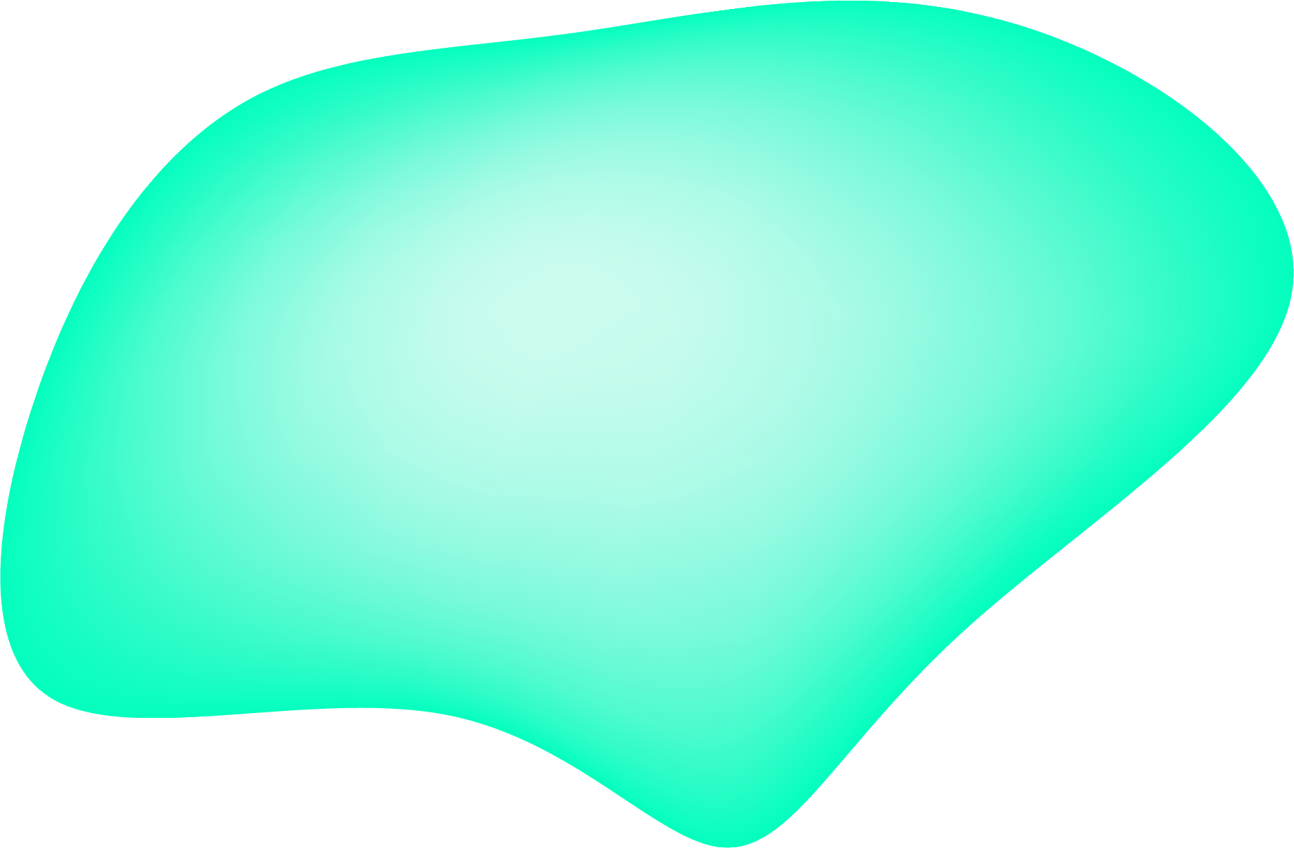
Real Time Green Screen & Blurring
Gustavo Fonseca
Jason Vasko

Slide 2
Introduction
Goal
Real Time Green Screen and Portrait Mode using the tablets camera
Algorithm
Uses Foreground & Background segmentation to identify changing pixels
App
Allows users to pick between the two modes and allows for different background for green screen mode.

Slide 3
Algorithm

Slide 4
Algorithm: Overview
Main Goal
4 Key Steps
Identify if a pixel is in the foreground or background
Foreground refers to things that are moving
Cluster Matching
Adaptation
Normalization
Classification

Slide 5
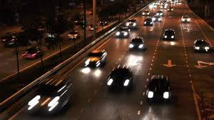
Cluster Matching
Each pixel has N number of clusters assigned to it
matches the new pixel values to the nearest cluster
Compare the shortest distance to a predefined threshold T (i.e. 10)
Cluster | Value | Weight
0 | 55 | 0.5
1 | 30 | 0.3
2 | 75 | 0.05
3 | 20 | 0.15

Slide 6
Adaptation: No Match
Update the clusters and weights
Smallest Weight Cluster Replaced
New Weight Set to the small value (i.e. 0.01)
New Pixel (220)
Cluster | Value | Weight
0 | 55 | 0.5
1 | 30 | 0.3
2 | 75 220 | 0.05 0.01
3 | 20 | 0.15

Slide 7
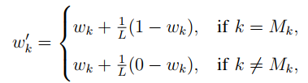
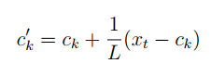
Adaptation: Match Found
Update the clusters and weights (L = 10)
Update all cluster weights based on the equation:
Centroid Value of the matched cluster:
New Pixel (15)
Cluster | Value | Weight
0 | 55 | 0.5 0.45
1 | 30 | 0.3 0.27
2 | 75 | 0.05 0.045
3 | 20 19 | 0.15 0.235

Slide 8
Normalization
normalize weights to sum to one
Weight Represents the probability of that value being part of the background
New Pixel (220)
Cluster | Value | Weight
0 | 55 | 0.5 0.52
1 | 30 | 0.3 0.31
2 | 75 220 | 0.05 0.01
3 | 20 | 0.15 0.16

Slide 9
Classification
sum all weights that have a weight higher than the matched cluster’s
Can make a threshold to determine foreground or background (i.e. 0.5)
0.52 + 0.31 + 0.16 = 0.99
99% chance of foreground
New Pixel (220)
Cluster | Value | Weight
0 | 55 | 0.5 0.52
1 | 30 | 0.3 0.31
2 | 75 220 | 0.05 0.01
3 | 20 | 0.15 0.16

Slide 10
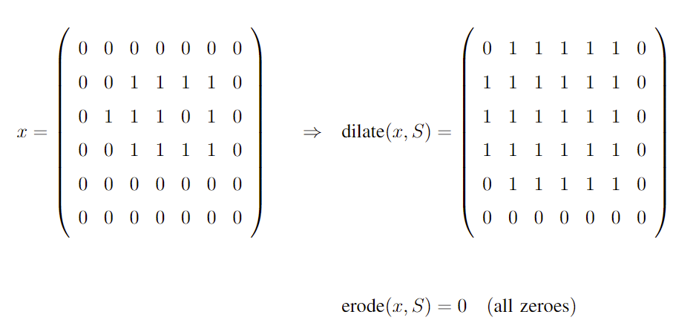
Post-Processing
Lot of Noise in initial segmentation
Used a Open Filter for this: Erode and then Dilate Filters

Slide 11
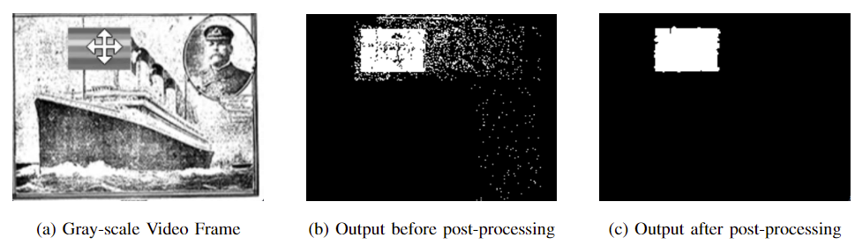
Results of Project Lab
Output
Things to improve
Identified moving objects
Extremely noisy
Very susceptible to exposure changes
Extremely Slow (~10 Frames/Sec)
Optimize runtime of algorithm
Lock video exposure
Fine tune the post-processing

Slide 12
App Features: Green Screen
User Can pick between 3 different backgrounds: Mountains, Forest, and Beach
All pixels found to be foreground will be unchanged, otherwise the pixel is replaced

Slide 13
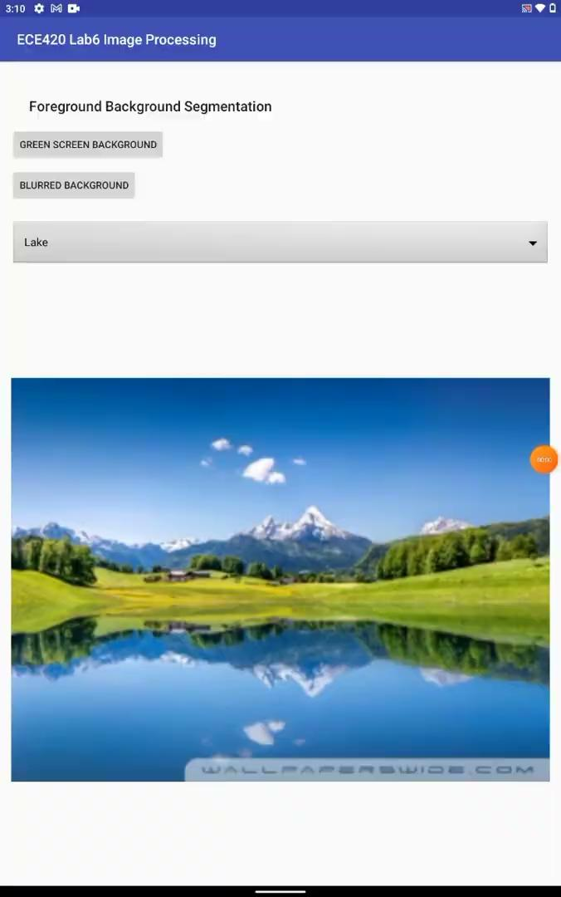
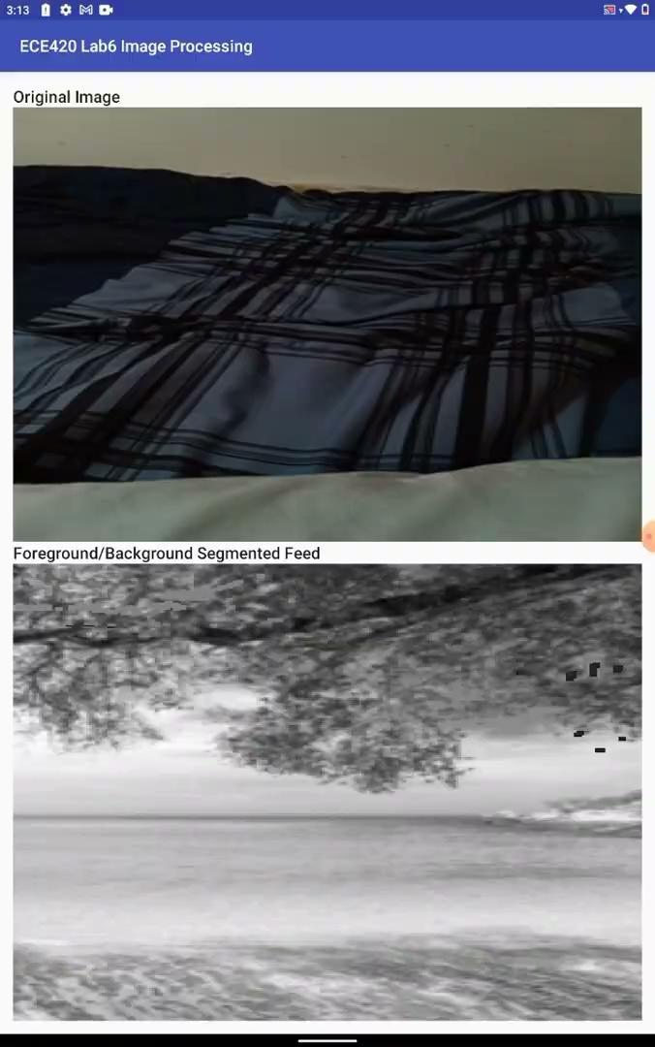
App Example: Green Screen

Slide 14
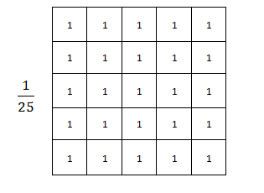
App Features: Portrait Mode
All pixels found to be foreground will be unchanged
If the pixel is from the background, then it will be replaced with a blurred version
Used a 5x5 Box Filter:

Slide 15
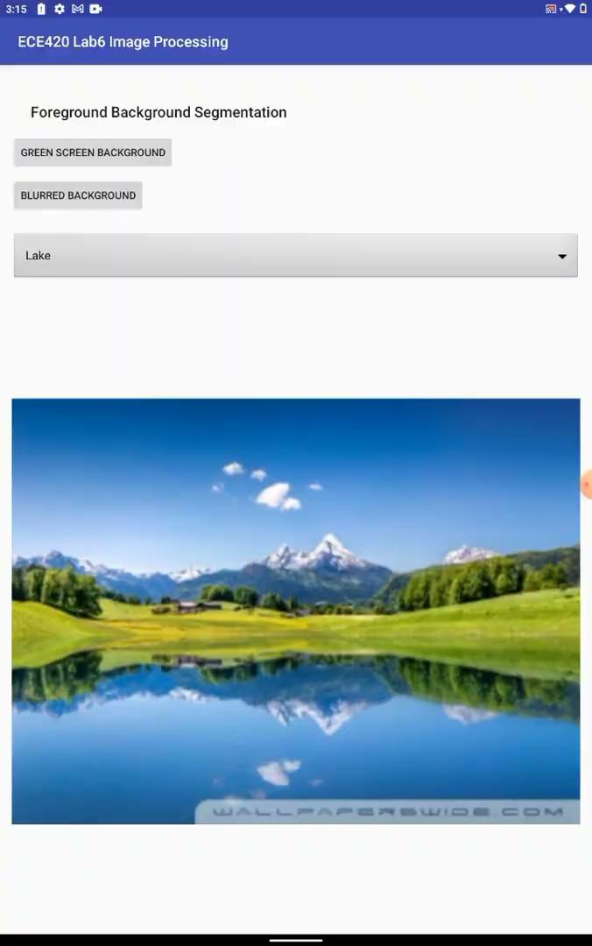
App Example: Portrait Mode

Slide 16
App Results
The app is able to work in real time
Using grayscale and small resolution for faster results
Built every function from scratch
Including all post processing
User can pick between the two modes in the home screen

Slide 17
Conclusion
App accomplished every goal of MVP
Has both Portrait and Green Screen Modes
Applies the algorithm to a video taken from the tablet’s camera
Allows the user to choose either method at start up
The Stretch goals we completed were
Real Time Application of the algorithm to live video feed
Multiple background choices
Implemented every function without the use of openCV

Slide 18
Thank You!

